Slide 1
Secondary school No 121
SENIOR PUPILS DEVELOPMENT OF RATIONAL NATURAL RESOURCES CONSUMPTION
Presented by Zlata Minaycheva and Yulia Mikheyeva

Slide 2
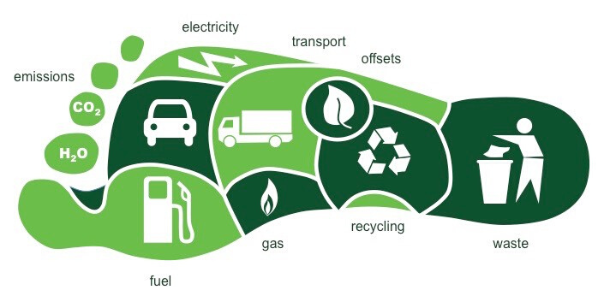
What is ecological footprint?

Slide 3

Ecological footprint of pupils
+
2 planets for each to cover the needs

Slide 4




Ecological footprint of pupils
95%
43%
78%
38%
live in a flat
public transportation
take shower
recycle paper

Slide 5






DIET
57%
43%
0%
2-3 times/week
every day
vegeterian

Slide 6



BEFORE
AFTER
calculating ecological footprint
23 %
77 %
WANT TO RATIONALLY CONSUME
WANT TO RATIONALLY CONSUME

Slide 7

BEFORE
AFTER
calculating ecological footprint
56 %
23 %
CALL THEMSELVES AS RATIONAL CONSUMERS
CALL THEMSELVES AS RATIONAL CONSUMERS

Slide 8
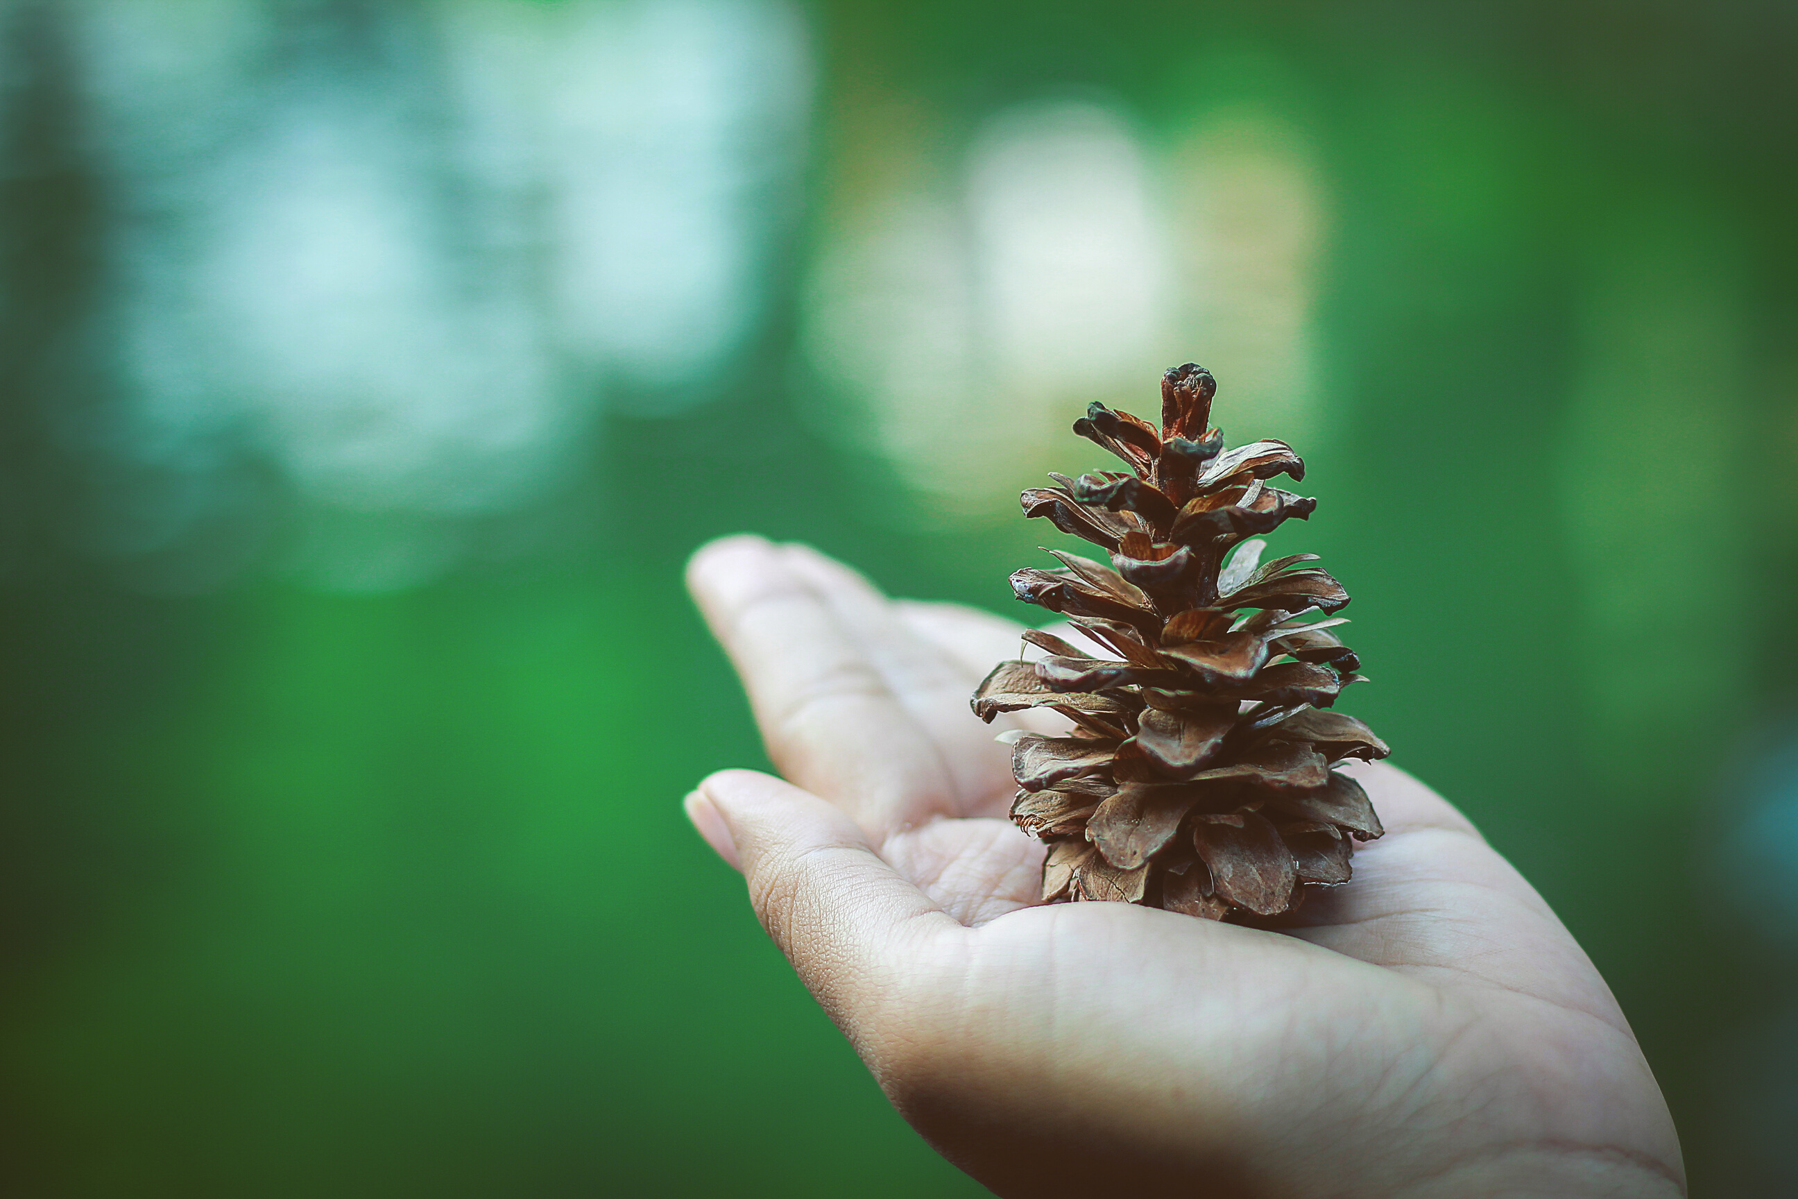
THINK GLOBALLY
ACT LOCALLY
by social activist Patrick Geddes

