Slide 1

IRINA KAZIUCHYTS
YANA DABRAHOST
Eco-labeling of products as a way to improve environmental awaraness
School No 121

Slide 2

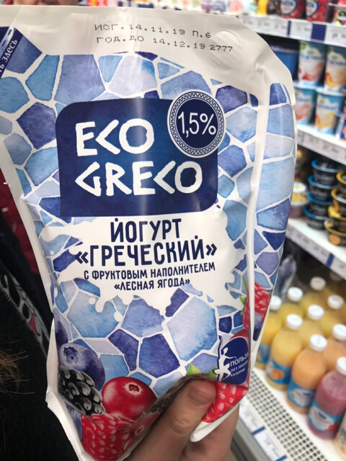
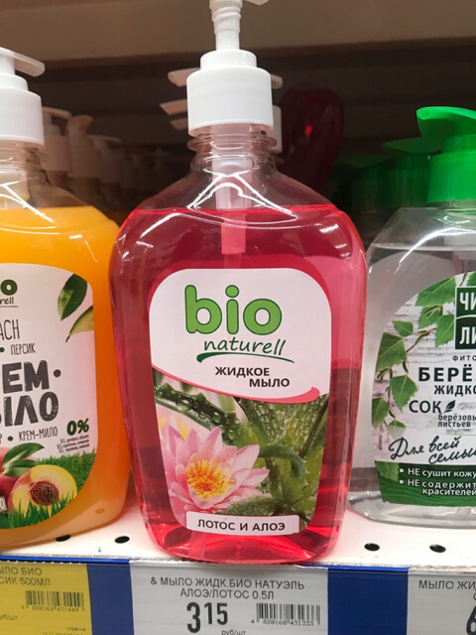
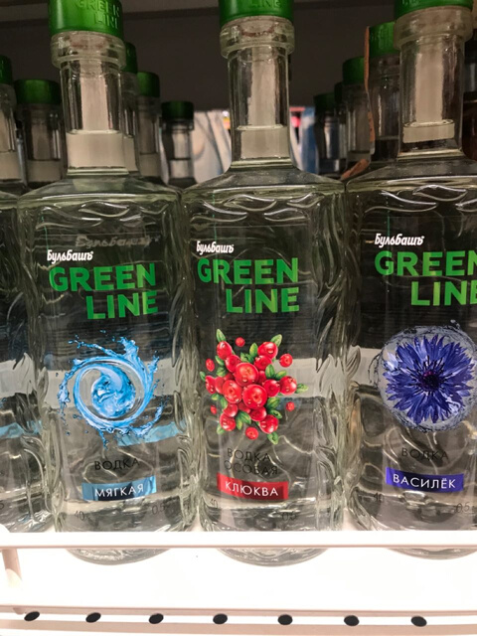
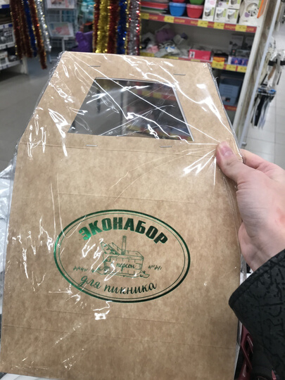
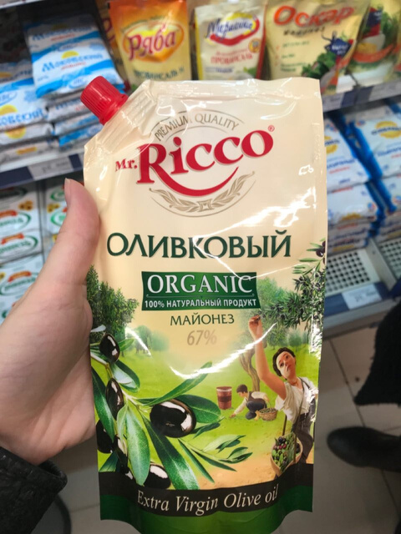
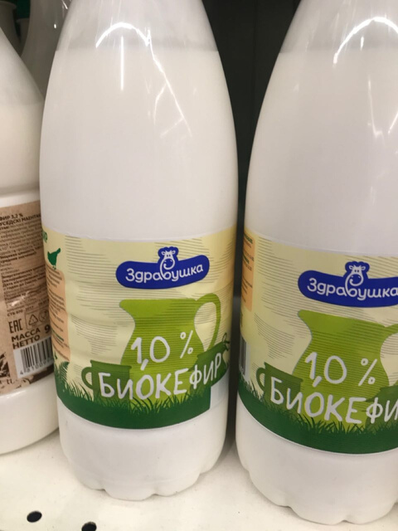
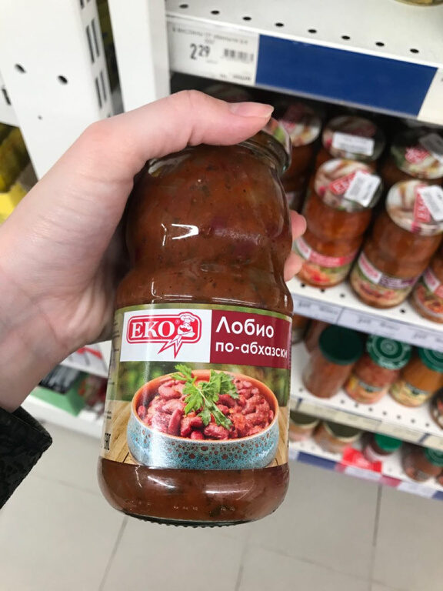
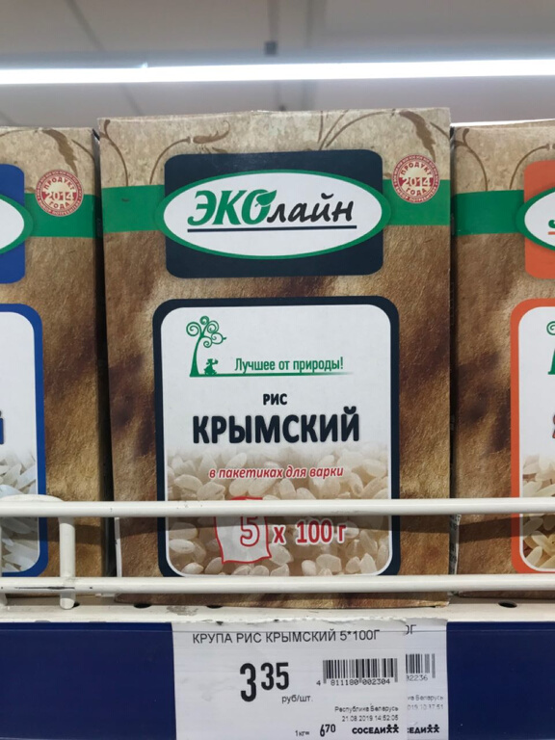
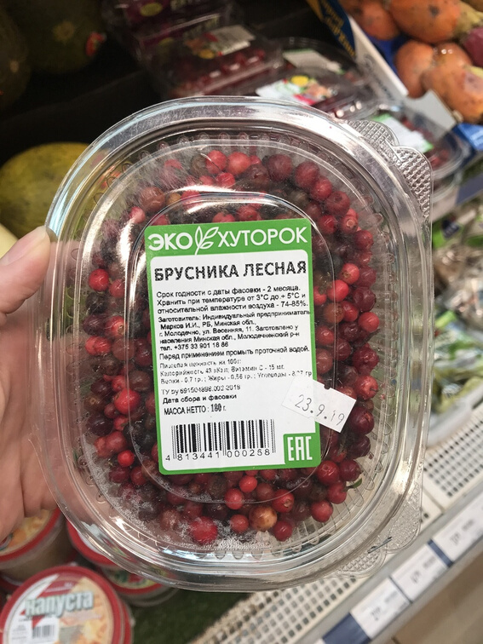
Are these products really organic, bio and eco?

Slide 3
Topics
To Cover
WHAT IS ECOLABEL?
DOES ECO-LABELING EXIST IN BELARUS?
DO PEOPLE KNOW ABOUT ECO-LABELS
GOALS OF WORK

Slide 4
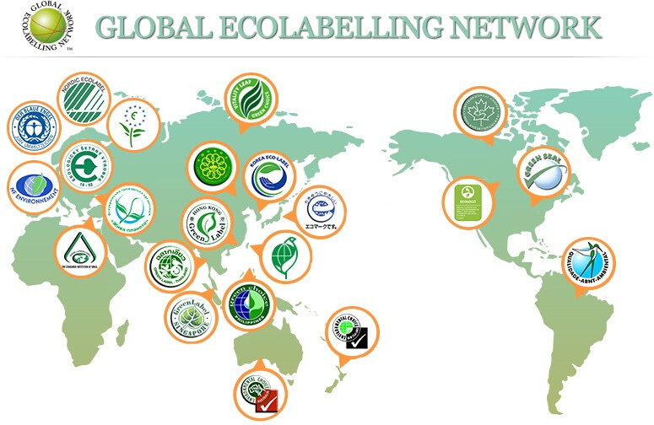
What is eco-labeling
graphic display of environmental friendliness

Slide 5



Innovative Environmental Technologies
Environmental Protection
Why eco-labeling is needed
Environmental Awareness Development

Slide 6
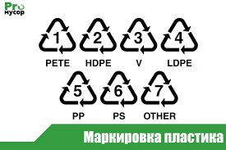



1
ECO-LABELLING IN BELARUS
  Plastic labels
  "Экологический знак соответствия РБ" (""Ecological mark of consordance of Belarus"
  "Натуральный продукт" ("Natural product")
  "Органический продукт" ("Organic product") took effect on Nov 18,2019
3
2
4

Slide 7
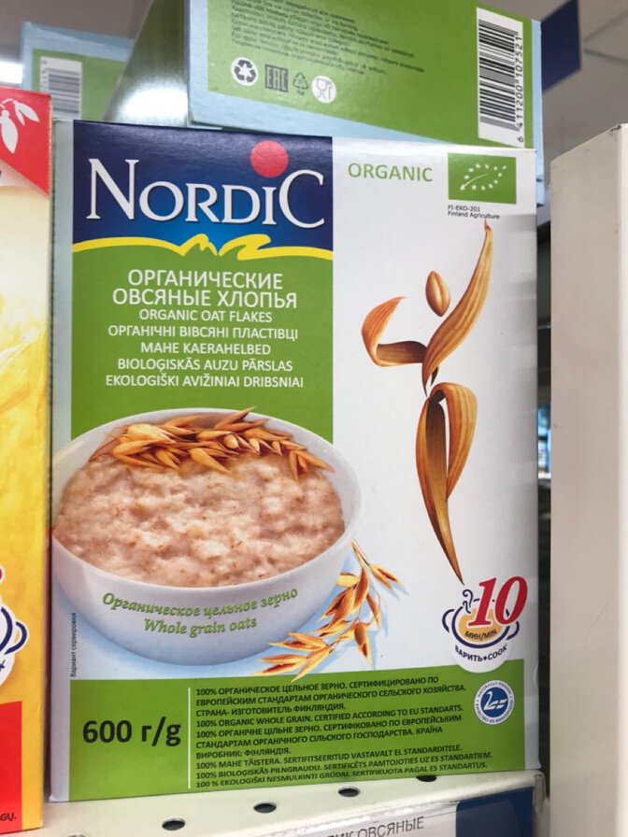
25 "Eco" products
ONLY!
1 certified

Slide 8
Do you know about eco-labeling?
No
32%
Survey
DO PEOPLE INTERESTED IN ECO-LABELING
Yes
52%
Heard about it
16%

Slide 9
What means eco-labeling for you?
Products containing only natural, natural ingredients
16%
54%
30%
Products, the production of which has a minimum negative impact on the environment
Safe products
for human health

Slide 10


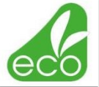

THE MOST RECOGNIZABLE ECO-LABELS
FALSE
ECO-LABELS

Slide 11
Are you ready to buy eco-products more expensive than usual?
No
45%
Yes
55%

Slide 12
Thank you!

